Slide 1
PROGRAMMING FUNDAMENTALS
FINAL PROJECT
Presented to: Mr. Adeel Khalid
Presented By:
Hajra Bashir FA24B1-CS-036
Noor Fatima FA24B1-CS-010
Misbah Ali FA24B1-CS-090
Sara Gul FA24B1-CS-001
Sadia Shabbir FA24B1-CS-013
Hoor-Ul-Ain FA24B1-CS-025

Slide 2
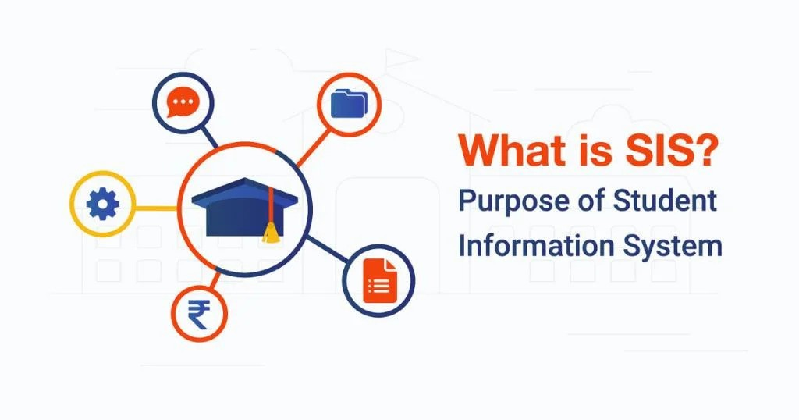
Student Information System in C
The SIS is a menu-driven program designed to manage student records efficiently, offering features like adding, viewing, updating, and deleting student information.

Slide 3
Program Overview
Functionality
Key Features
The SIS provides a user-friendly interface for managing student records. It utilizes a structured approach with a menu-driven system to guide users through various operations.
The program offers features such as adding new students, viewing existing student information, updating student details, deleting student records, and listing all students.

Slide 4
Data Structure
1
Student Structure
2
Data Storage
3
File Handling
The program utilizes a Student structure to represent individual student records. This structure contains fields for storing the student's roll number, name, age, and course.
Student data is stored in a static array, providing a simple and efficient way to manage a limited number of records.
The program uses binary files to store student data persistently. This ensures that data is saved even after the program is closed.

Slide 5
Adding a Student
Input Details
Array Storage
File Persistence
The add_student function prompts the user to enter the student's roll number, name, age, and course.
The new student's details are added to the students array, and the student_count is incremented.
The updated student data is written to the students.dat file in binary format, ensuring data persistence.

Slide 6
Viewing a Student
Roll Number Input
Data Retrieval
The view_student function prompts the user to enter the roll number of the student they wish to view.
The function searches the students array for a matching roll number. If found, it displays the student's details.

Slide 7
Updating a Student
Roll Number Input
Data Modification
The update_student function prompts the user to enter the roll number of the student they wish to update.
The function allows the user to modify the student's name, age, and course. The updated data is then written to the file.

Slide 8

Deleting a Student
1
Roll Number Input
The delete_student function prompts the user to enter the roll number of the student they wish to delete.
2
Array Removal
The function removes the student from the students array by shifting subsequent students to the left.
3
File Update
The updated student data is written to the students.dat file, effectively deleting the specified student.

Slide 9
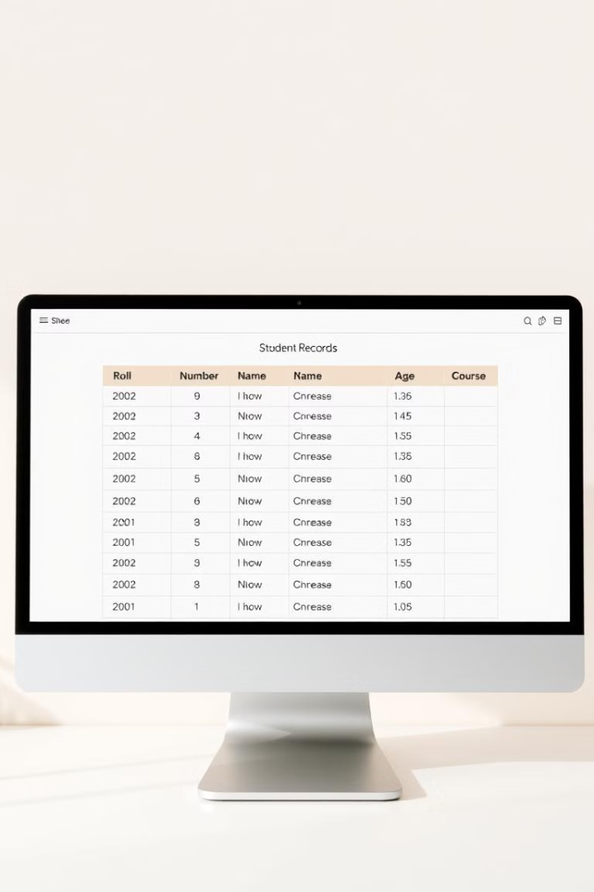


Listing All Students
Data Retrieval
The list_students function iterates through the students array and displays the details of each student.
Output Format
The student information is presented in a clear and organized format, making it easy for users to read and understand.

Slide 10





Program Limitations
Limited Search
1
The program only supports searching by roll number.
No Sorting
2
Students are listed in the order they were added.
No Encryption
3
Student data is stored in plain text.
Single User
4
The program doesn't handle concurrent modifications.
No Undo/Redo
5
There is no way to undo accidental operations.

Slide 11
Future Enhancements
Dynamic Memory
1
Replace the static array with dynamic memory for scalability.
Error Handling
2
Handle file operation failures more robustly.
Modular Design
3
Separate file operations and student management logic.

